Slide 1






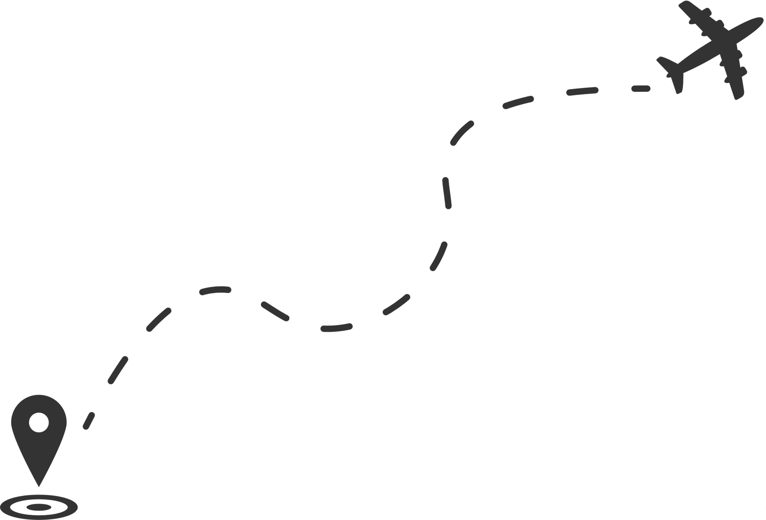








Optimized Flight Trip
CCE414-Artificial Intelligence
2023-2024

Slide 2
TEAM MEMBERS
AHMED MOHAMED FAWZY
PASSANT EL-TONSY ALI
SAIF EMAD EL-DEN
MOHAMED EMAD FAWZY
Under Supervision
Prof.Dr. Lamiaa El-Refaei
Dr.Mohamed Rehan

Slide 3














2-Problem Formulation
4-BFS
6-DLS
1-Explore Data
3-Construct Flight Trip
5-DFS
7-IDS
AGENDA
10-Comparison
9-GREEDY
8-UCS
10-A*

Slide 4


Explore Data

Slide 5
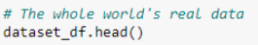
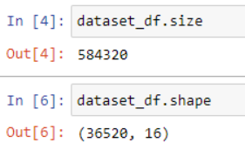
02
01
Loading Data from the dataset file
Read head to get the first 5 rows
03
04
Getting size and shape
Getting ranges of altitude and longitude

Slide 6
Problem Formulation

Slide 7

Initial State
Goal Test
The constructor specifies the initial state, and possibly a goal
state, if there is a unique goal. Your subclass's constructor can add
other arguments
Return True if the state is a goal. The default method compares the state to self .goal or checks for state in self. goal if it is a list, as specified in the constructor. Override this method if checking against a single self.goal is not enough.
def __init__(self, initial, goal=None):
self.initial = initial
self.goal = goal
def goal_test(self, state):
if isinstance(self.goal, list):
return is_in(state, self.goal)
else: return state == self.goal
Actions
Return the actions that can be executed in the given state. The result would typically be a list, but if there are many actions, consider yielding them one at a time in an iterator, rather than building them all at once.
Problem Class
def actions(self, state):
raise NotImplementedError
Path Cost
Transition Model
Compute the cost of reaching state2 from state1 via a specific action, given initial cost c. If path details are irrelevant, focus on state2; otherwise, consider c, state1, and action. Default step cost is 1.
Return the state that results from executing the given action in the given state. The action must be one of self.actions(state).
def path_cost(self, c, state1, action, state2):
return c + 1
def result(self, state, action):
raise NotImplementedError

Slide 8
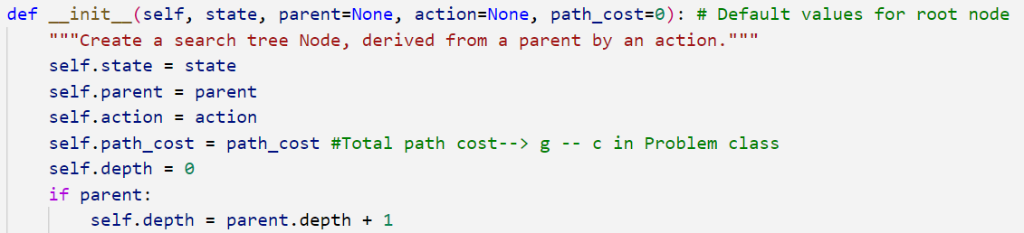
solution()
List the nodes reachable in one step from this node.
Return the sequence of actions to go from the root to this node.
expand()
Node
path()
Return a list of nodes forming the path from the root to this node.
Return the next node from an action on a specific node.
child_node()

Slide 9
constructor
Return a link distance or a dict of {node: distance} entries.
.get(a,b) returns the distance or None;
.get(a) returns a dict of {node: distance} entries, possibly {}.
get()
def __init__(self, graph_dict=None, directed=True):
self.graph_dict = graph_dict or {}
self.directed = directed
if not directed:
self.make_undirected()
Make a digraph into an undirected graph by adding symmetric edges.
make_undirected()
Graph
Return a list of nodes in the graph.
nodes()
Add a link from A and B of given distance, and also add the inverse
link if the graph is undirected.
connect()

Slide 10

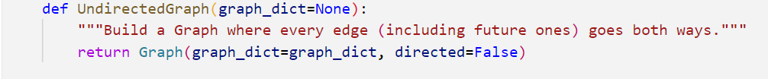
To construct a bidirectional graph.

Slide 11
Initial State
Path Cost
def path_cost(self, cost_so_far, A, action, B):
return cost_so_far + (self.graph.get(A, B) or np.inf)
# get(a,b) --> get the distance between node a and b
def __init__(self, initial, goal, graph):
super().__init__(initial, goal)
self.graph = graph
Actions
Graph Problem
def actions(self, A):
"""The actions at a graph node are just its neighbors."""
return list(self.graph.get(A).keys())
Heuristic
Transition Model
def h(self, node):
"""h function is straight-line distance from a node's state to goal."""
locs = getattr(self.graph, 'locations', None)
if locs:
if type(node) is str:
return int(distance(locs[node], locs[self.goal]))
return int(distance(locs[node.state], locs[self.goal]))
else:
return np.inf
def result(self, state, action):
"""The result of going to a neighbor is just that neighbor."""
return action

Slide 12
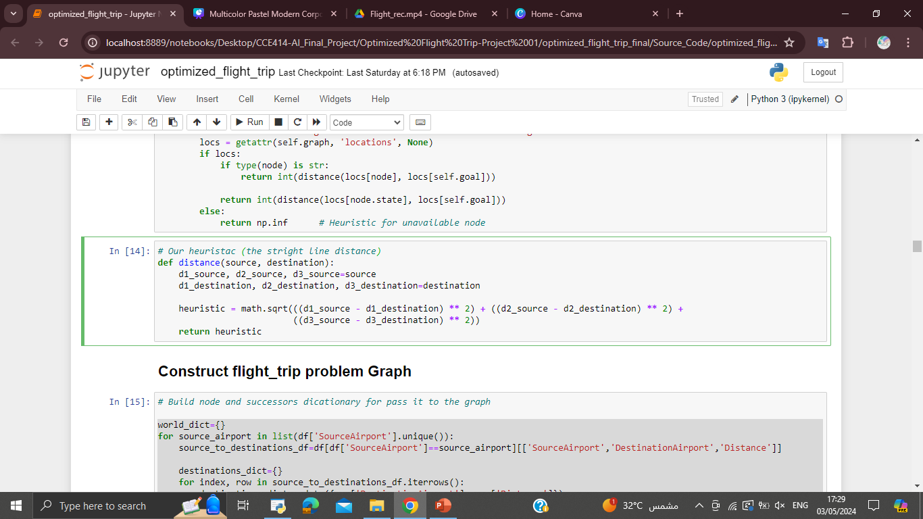
Our Heuristic

Slide 13
Construct Flight Trip

Slide 14
Build node and successors dictionary for passing it to the graph
world_dict= { }
for source_airport in list(df['SourceAirport'].unique()): source_to_destinations_df=df[df['SourceAirport']==source_airport][['SourceAirport','DestinationAirport','Distance']]
destinations_dict={}
for index, row in source_to_destinations_df.iterrows():
destinations_dict.update({row['DestinationAirport']: row['Distance']})
world_dict.update({source_airport: destinations_dict})

Slide 15
instantiate Undirected Graph.
world_map=UndirectedGraph(world_dict)
Locations in Latitude, Longitude and Altitude for calculate Heuristic function.
locations_dict={}
for nod in list(df['SourceAirport'].unique()):
nod_df=df[df['SourceAirport']==nod][['SourceAirport_Latitude','SourceAirport_Longitude','SourceAirport_Altitude']]
locations_dict.update({nod:tuple(nod_df.iloc[0])})

Slide 16
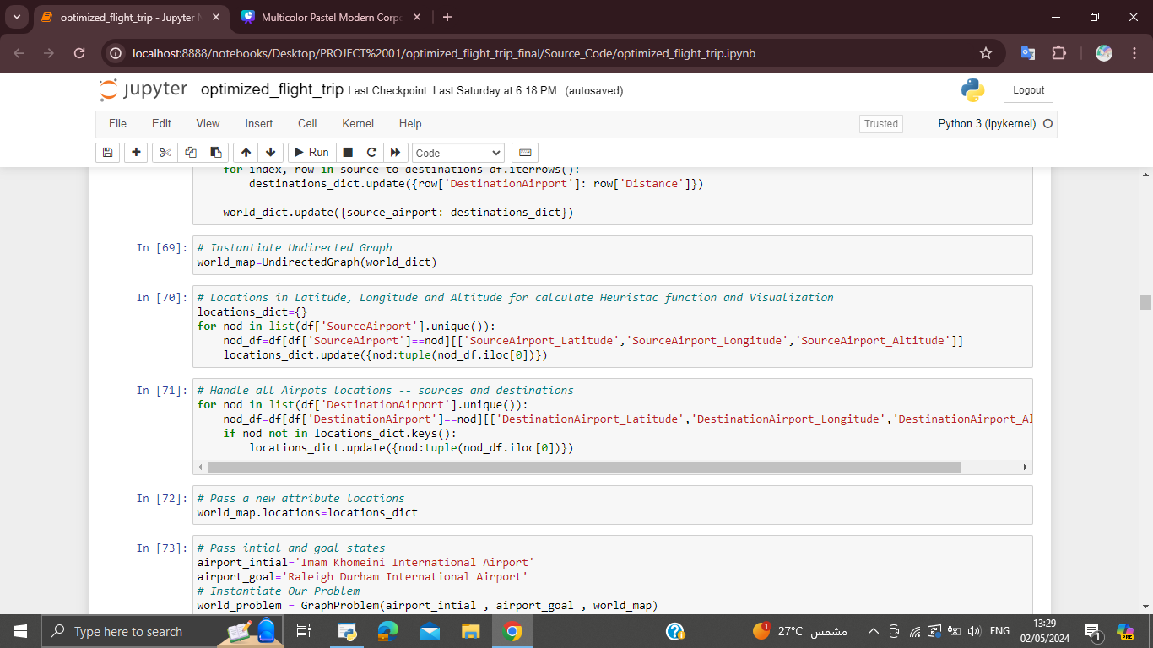
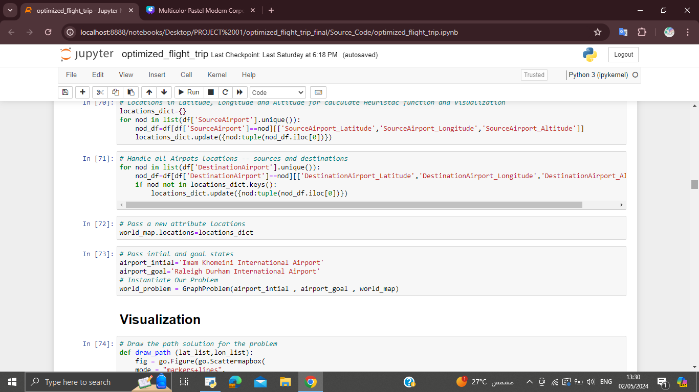
• Handle all Airports locations -- sources and destinations then pass a new attribute location
• Pass initial and goal states then instantiate our problem from 'Imam Khomeini International Airport' to 'Raleigh Durham International Airport'.

Slide 17
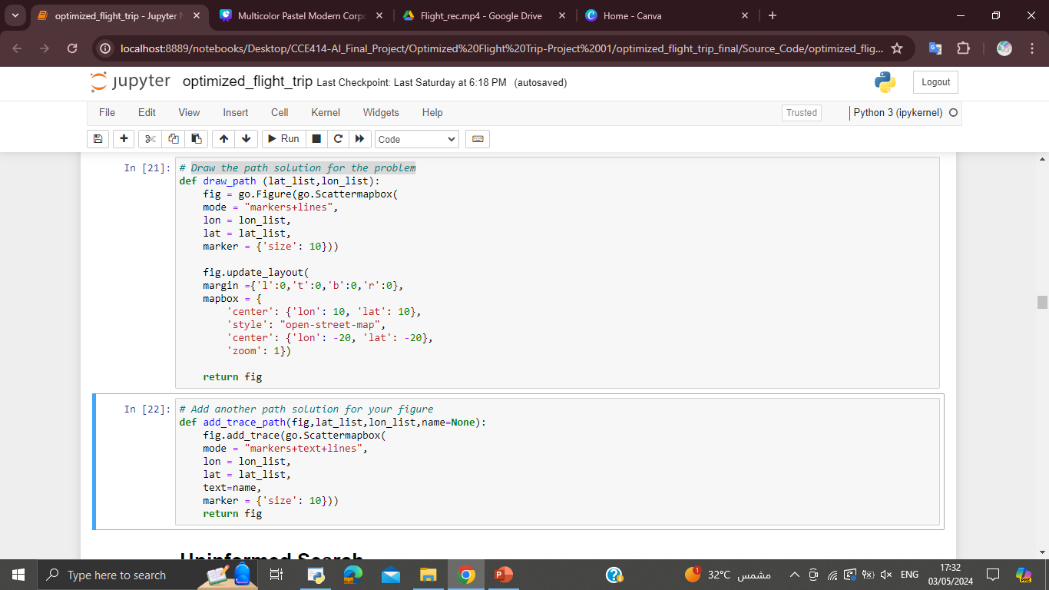
Draw the path solution for the problem:
01.
Add another path solution for your figure:
02.

Slide 18
Uninformed Search Algorithms

Slide 19
Breadth-First Search (BFS)

Slide 20
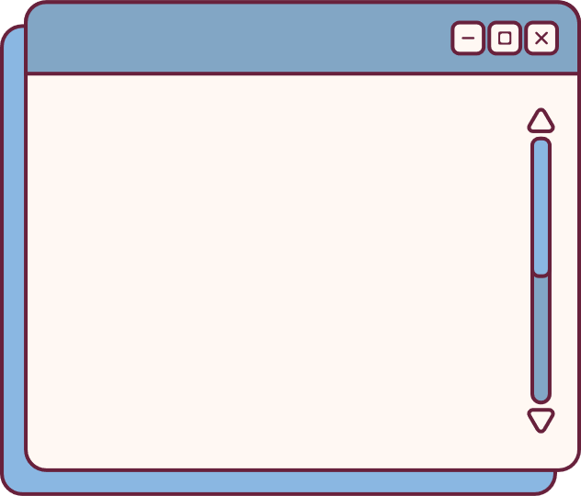
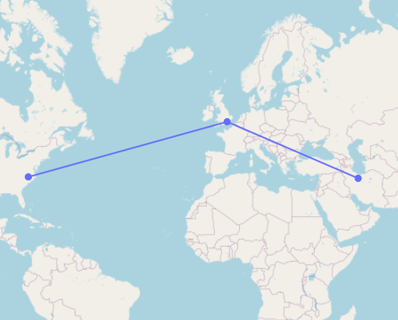
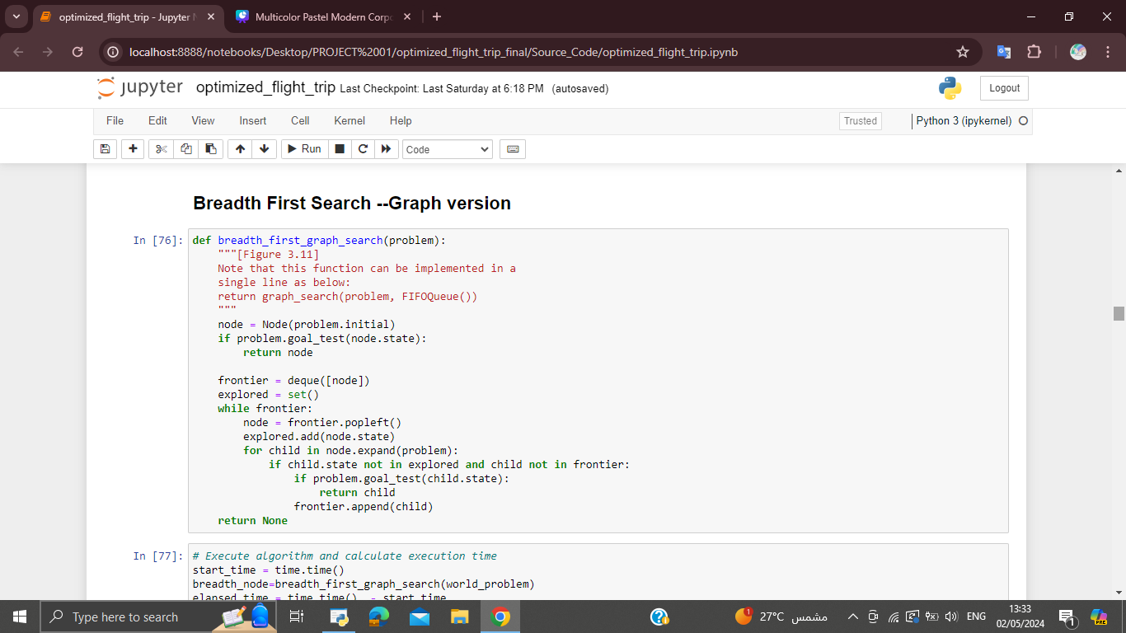
RESULT
Breadth-First Search (BFS)
Execution Time: 0m 0.08027s

Slide 21
Depth First Search

Slide 22
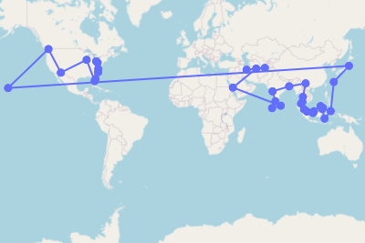
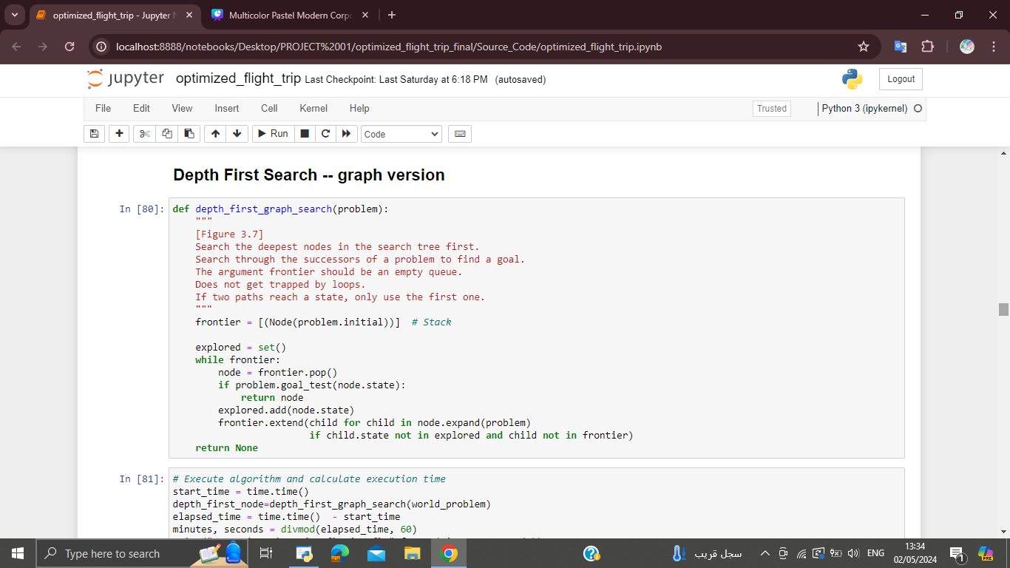
RESULT
Depth First Search
Execution Time: 0m 0.62034s

Slide 23
Depth Limited Search

Slide 24
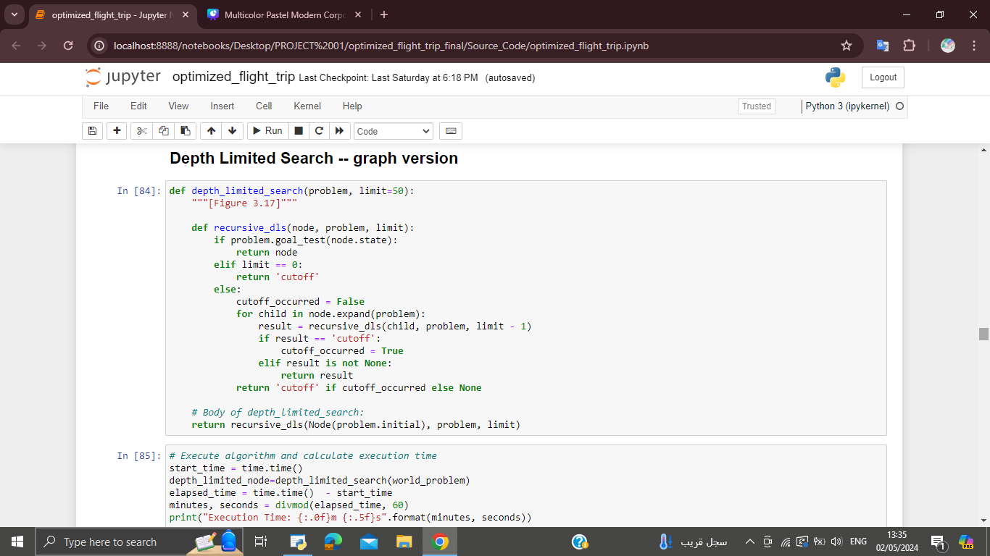
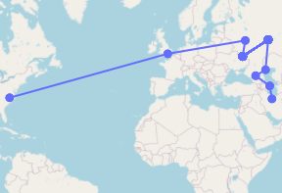
RESULT
Depth Limited Search
Execution Time: 0m 0.01248s

Slide 25
Iterative Deepening Search

Slide 26
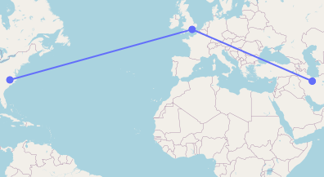
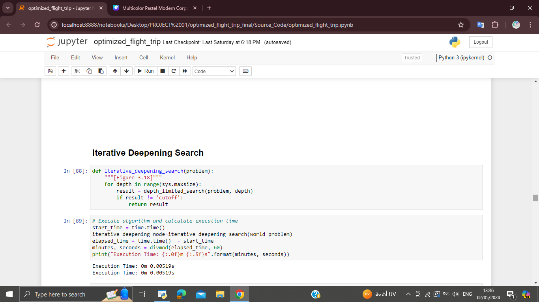
RESULT
Iterative Deepening Search
Execution Time: 0m 0.00519s

Slide 27
Uniform Cost Search

Slide 28
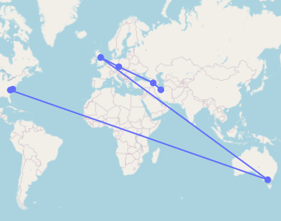
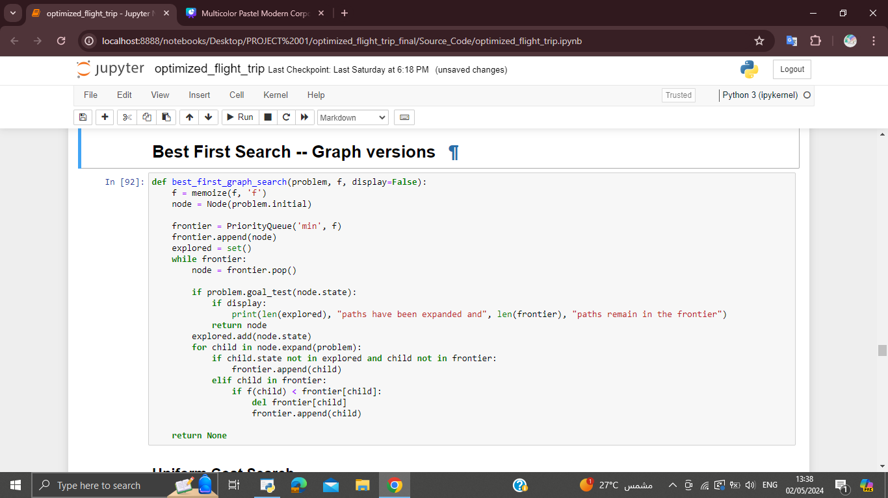
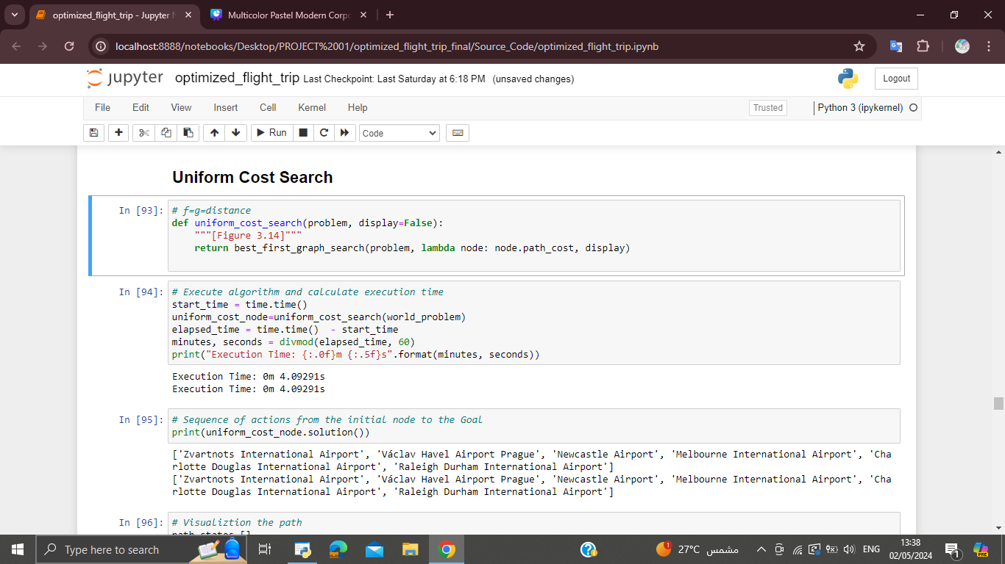
RESULT
Uniform Cost Search
Execution Time: 0m 4.09291s

Slide 29
Informed Search Algorithms
( Best First Search )
1-Greedy Search Algorithm
2-A* Search Algorithm

Slide 30
Greedy Search Algorithm

Slide 31
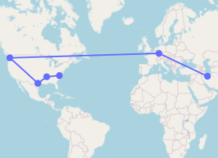
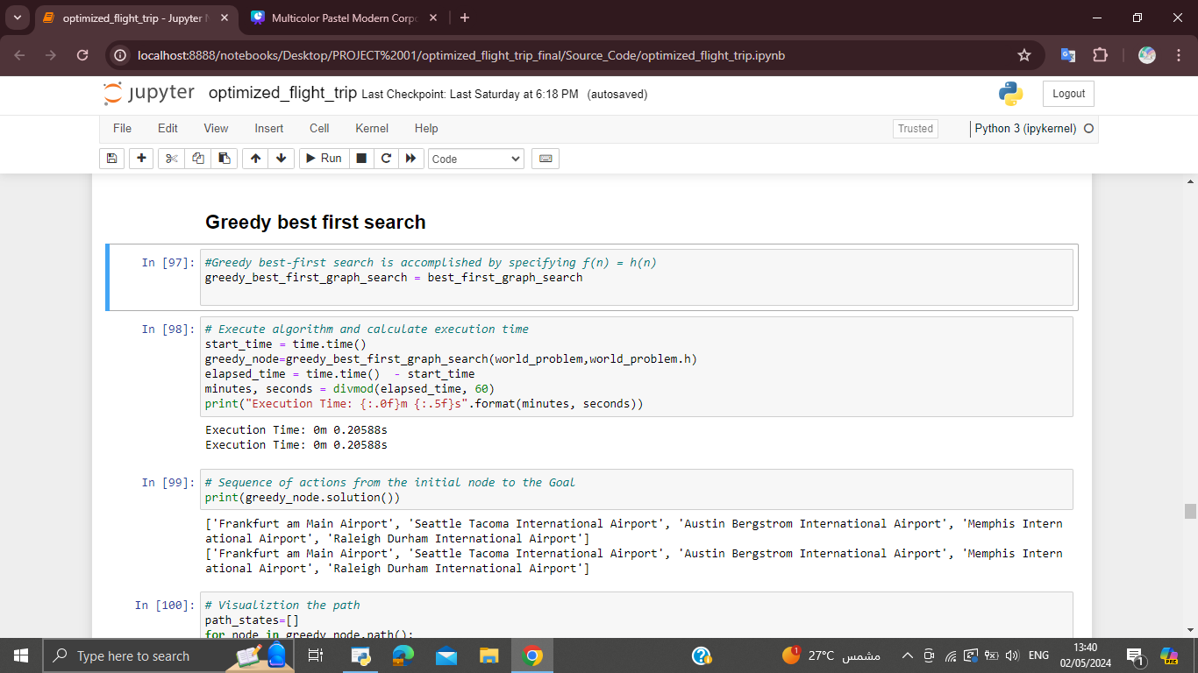
RESULT
Greedy Search Algorithm
Execution Time: 0m 0.20588s

Slide 32
A* Search Algorithm

Slide 33
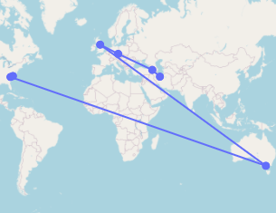
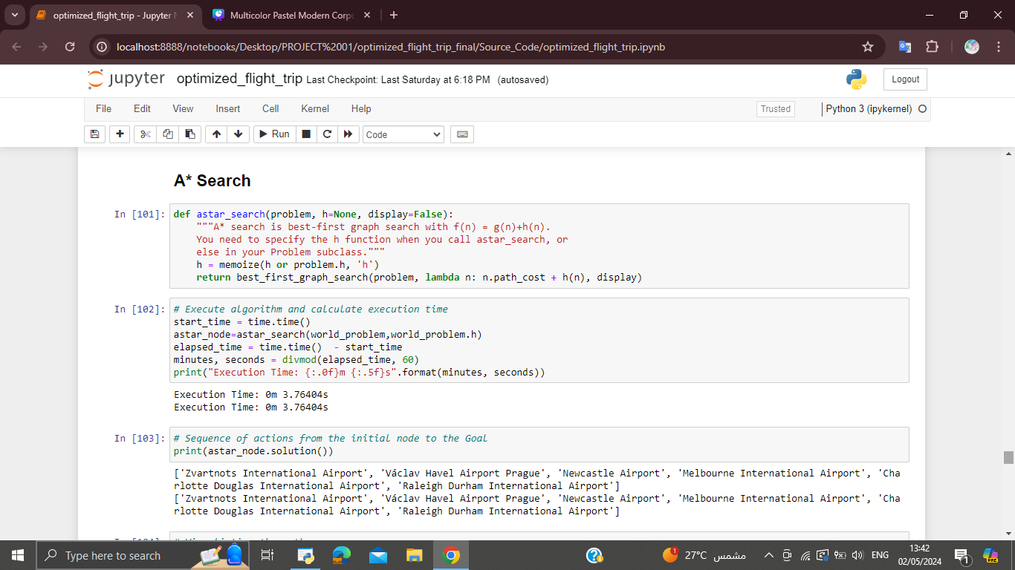
RESULT
A* Search Algorithm
Execution Time: 0m 3.76404s

Slide 34
Comparison
1- Different Paths
2-Execution Time

Slide 35
Different Paths

Slide 36
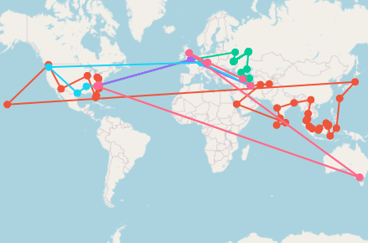
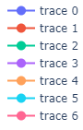
RESULT

Slide 37
Execution Time

Slide 38
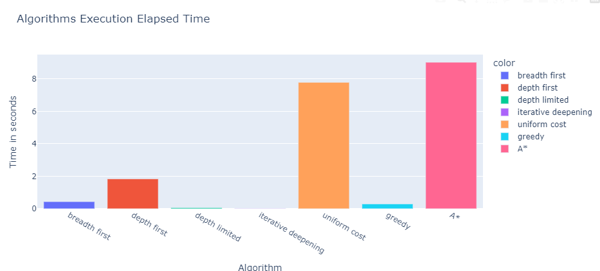
RESULT

Slide 39
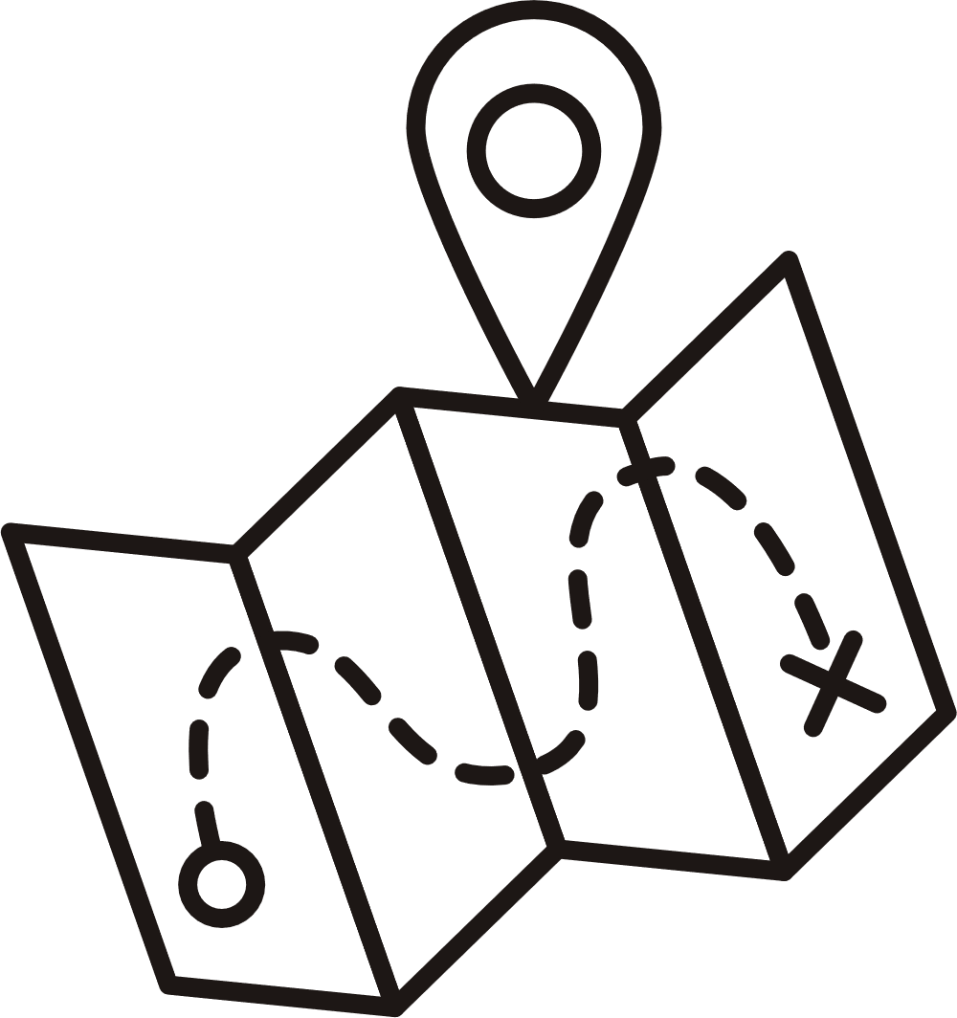

THANK YOU

